Slide 1

Welcome!
Back to School Night 2021

Slide 2
Welcome to back to school night!
Ms. Donna Swenticky
Subjects: Biology & Conceptual Science
Phone: 732-833-4701
Email: dmswenticky@jacksonsd.org
Paraprofessional: Mr. Vega -Conceptual Science
Mr. Holup -Biology

Slide 3
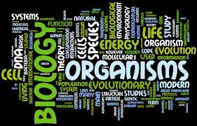
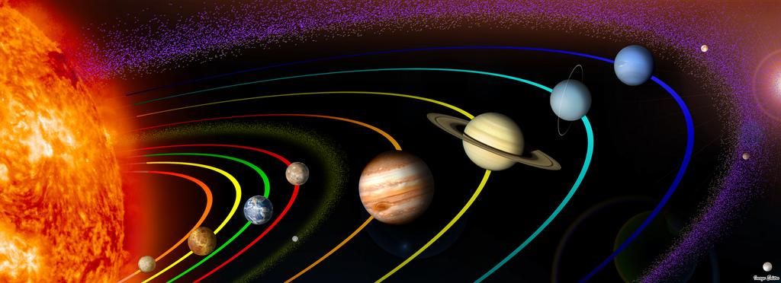
Mission
To provide students with hands-on lab experience.
Integrate technology – via internet, google, and wireless chromebooks in the classroom.

Slide 4
Strategies for Parents
Checking Genesis and Google classroom!
Don’t hesitate to email me with questions.
Ensure that students keep organized, utilize their chromebooks, participate, and turn in all assignments to our google classroom.
Encourage your student to utilize the online textbook study tools.

Slide 5

Things that help at home
Keeping important papers and materials somewhere special, the final exam is cumulative.
Have your student talk to you about what they are doing.
Check their doing assignments
and studying.

Slide 6


Grading
Biology & Conceptual Science
Tests, quizzes, projects: 40 %
Homework: 35 %
Classwork and participation: 25% - includes labs, do nows, participation, and classwork assignments- drills, practice, and behavioral expectations

Slide 7
Make- up work
Missing assignments: students have one day to make up assignment after an absence.
Quizzes and tests need to be made up after school.
A zero for an assignment becomes permanent if the answers are given in class unless the student is absent.

Slide 8
Technology
We are online!
  Check out my class pages
  Class pages can be accessed from the school website.
  Each class has a Google Classroom

Slide 9
Extra Help
I am here to assist your child.
Use school gmail to contact me with concerns on homework, or questions.
I will do my best to respond back.

Slide 10
Thanks for stopping by
Thank you for taking the time to visit my classroom this evening.
We look forward to an exciting semester, filled with success.

